Slide 1

Analysis On University Students Sleeping Patterns
Why this topic?

Slide 2
Analysis On University Students Sleeping Patterns
Why this topic?

Slide 3
Analysis On University Students Sleeping Patterns
Why this topic?
Understanding sleep patterns in university students is essential because it directly impacts academic performance, mental health, and overall well-being. Sleep is crucial for cognitive functioning, memory consolidation, and stress management.
Somay (38027)
Shivam (38040)
Anand
Keshav (38046)
However, university students often face irregular schedules, workload pressures, and social influences that can disrupt healthy sleep. By analyzing sleep patterns, we can identify trends, challenges, and potential interventions to promote better sleep habits, enhancing students' academic outcomes and long-term health.

Slide 4
Tools and Data Info
Python
Jupyter Notebook
Numpy
Pandas
Matplotlib
Seaborn

Slide 5


Tools and Data Info
Platform: Kaggle
Collected By: Arsalan Jamal in 2024
Sample Size: [Number of students]
Data Points Collected: Sleep duration, bedtime, wake-up time, academic workload, and lifestyle habits.
Shape:

Slide 6

Tools and Data Info

Slide 7

Tools and Data Info

Slide 8
Tools and Data Info

Slide 9
VISUALIZATIONS OF THE DATASET

Slide 10


VISUALIZATIONS OF THE DATASET

Slide 11

VISUALIZATIONS OF THE DATASET

Slide 12

VISUALIZATIONS OF THE DATASET

Slide 13
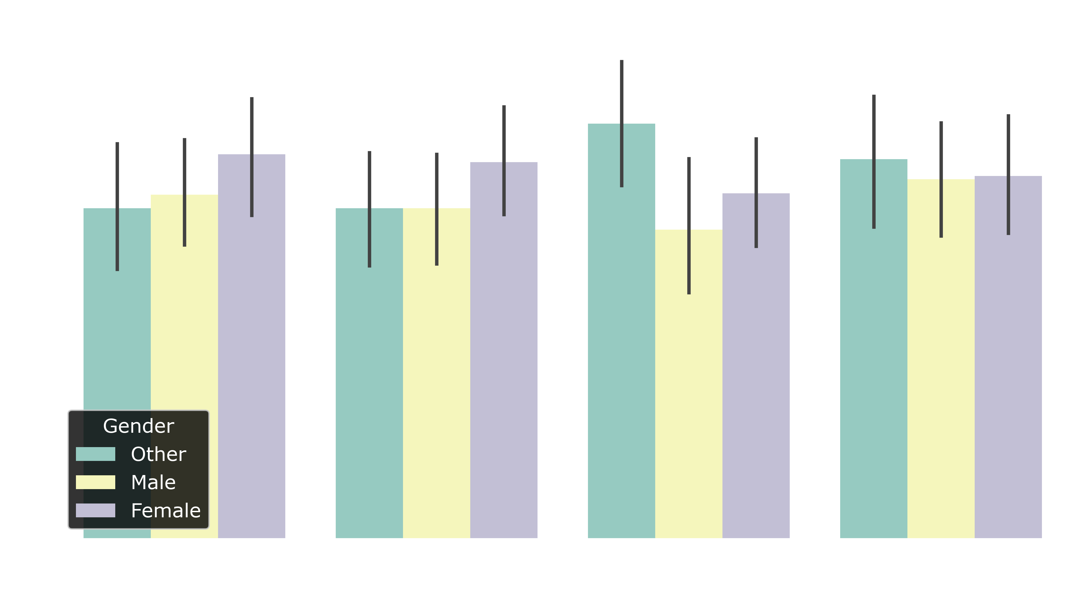
VISUALIZATIONS OF THE DATASET

Slide 14


VISUALIZATIONS OF THE DATASET

Slide 15
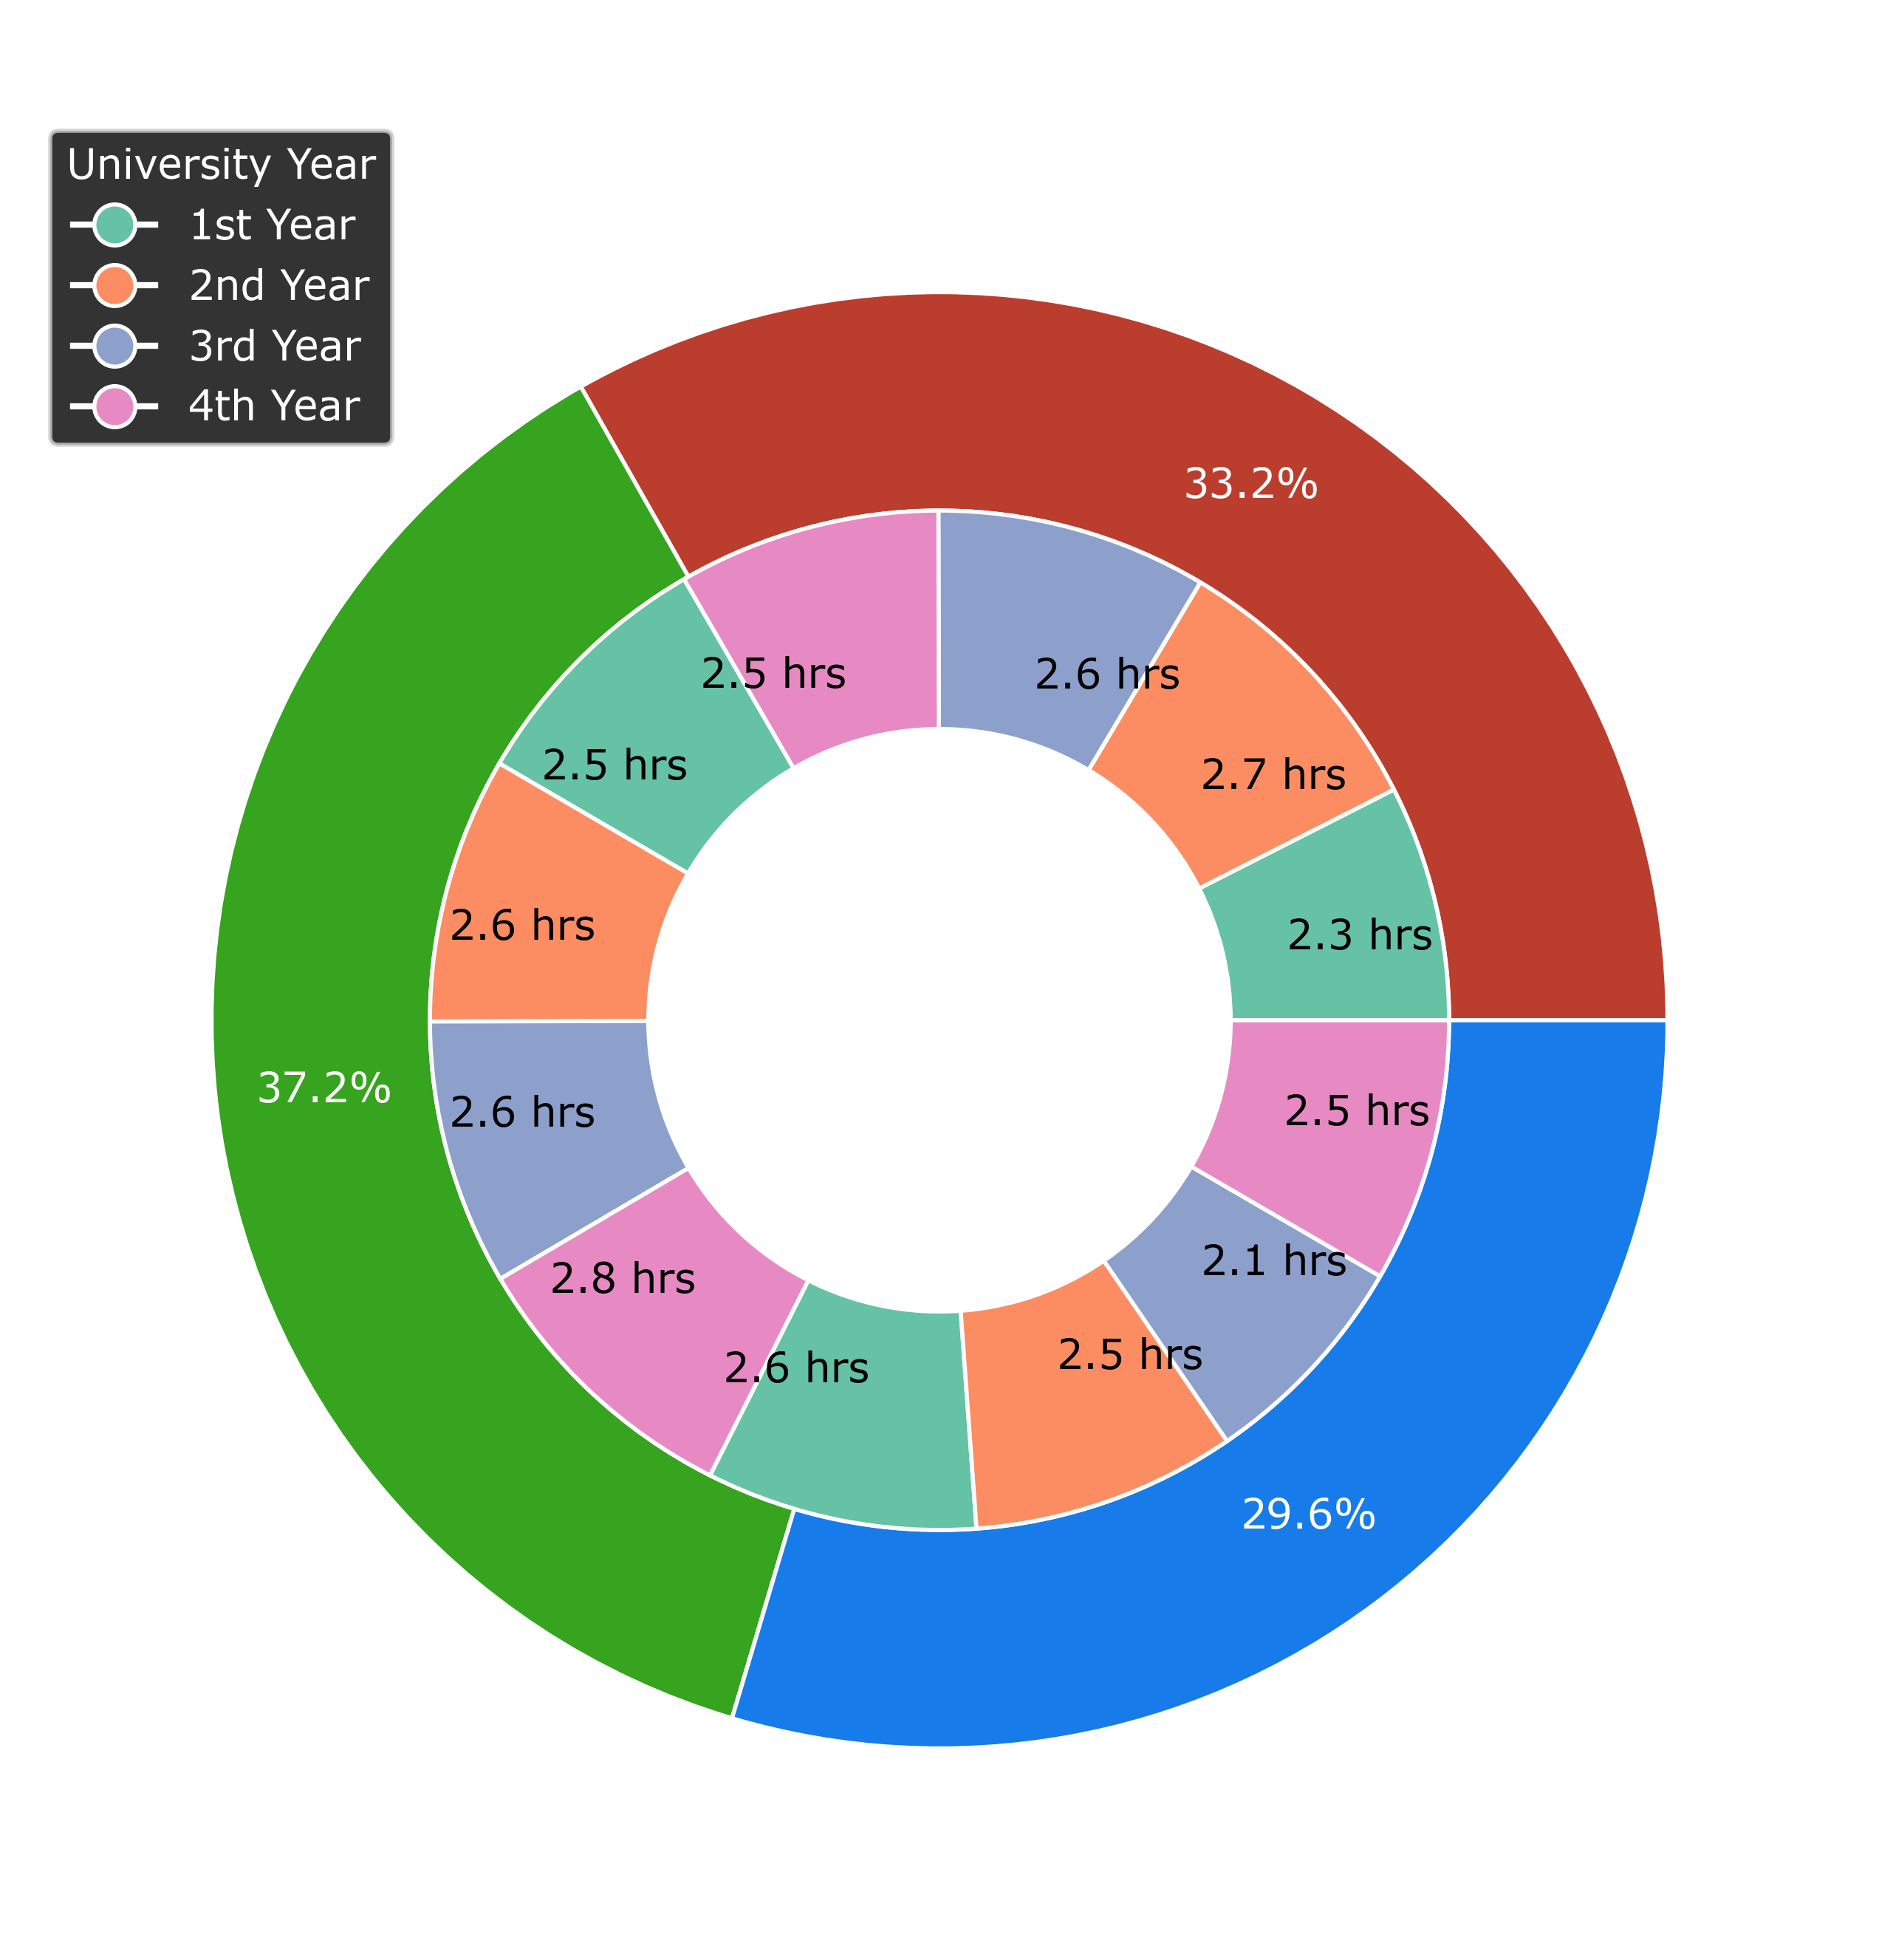
VISUALIZATIONS OF THE DATASET

Slide 16



Sleep Quality Category

Slide 17
Sleep Quality Category

Slide 18

How Quality Sleep affects Academic Performance?
Good sleep is essential for learning and remembering information. They can focus better in class, remember what they studied, and solve problems more easily.
Poor sleep, on the other hand, makes it harder to concentrate, leads to forgetfulness, and increases stress and anxiety, which can make schoolwork feel overwhelming.

Slide 19
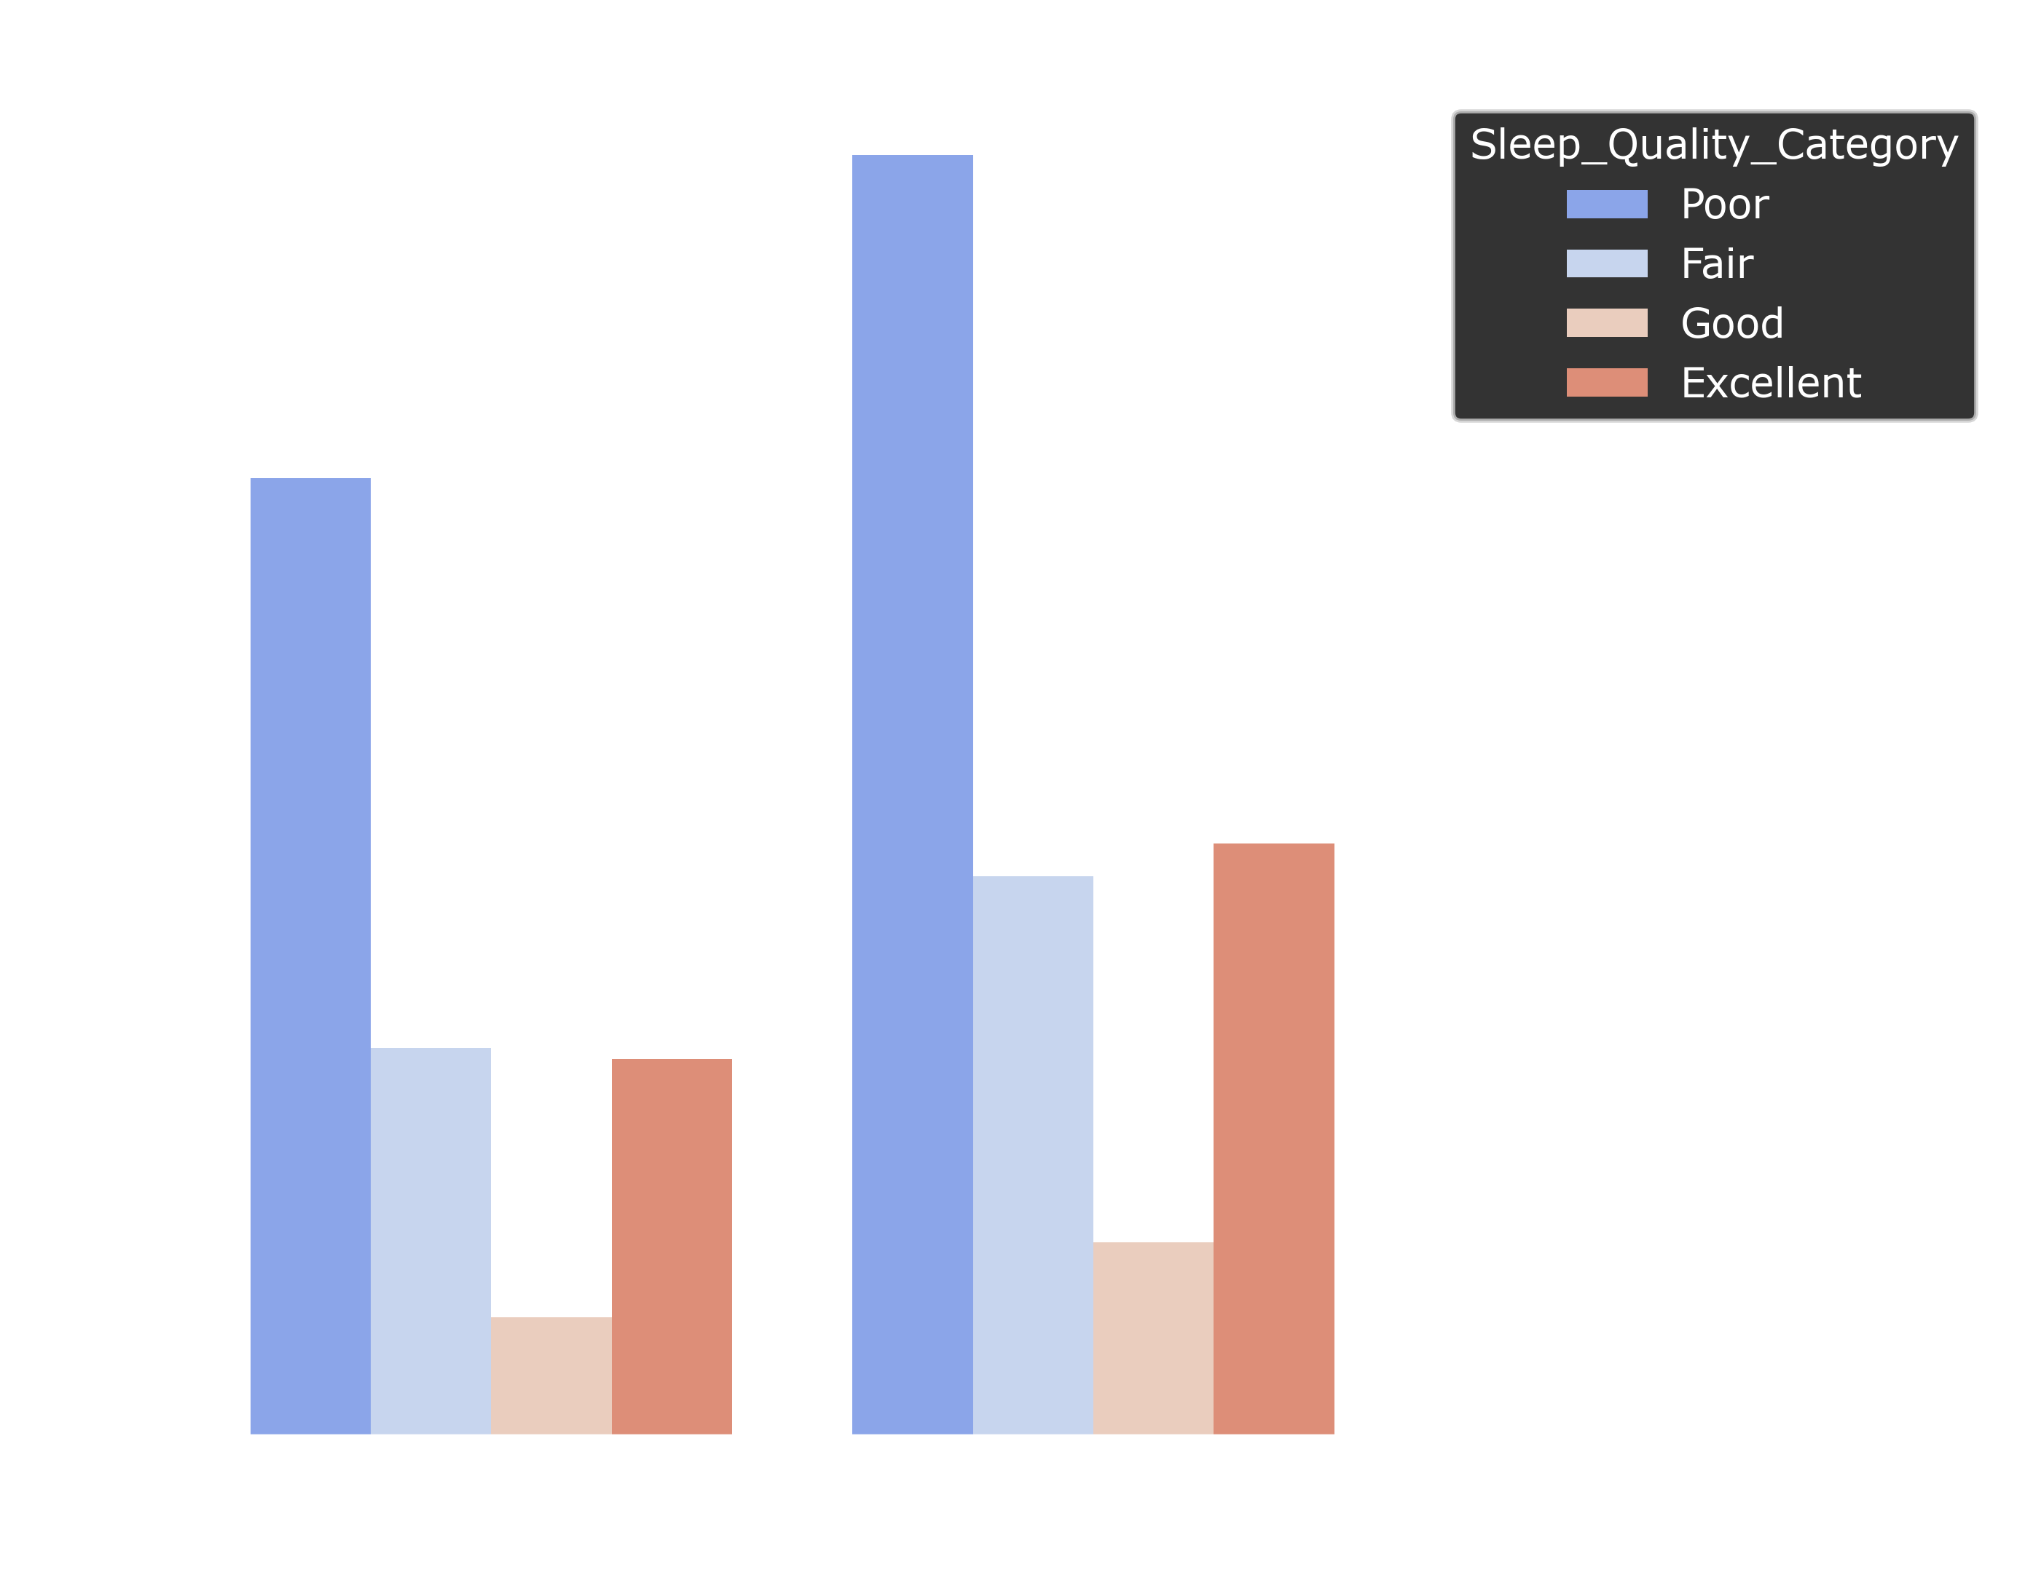
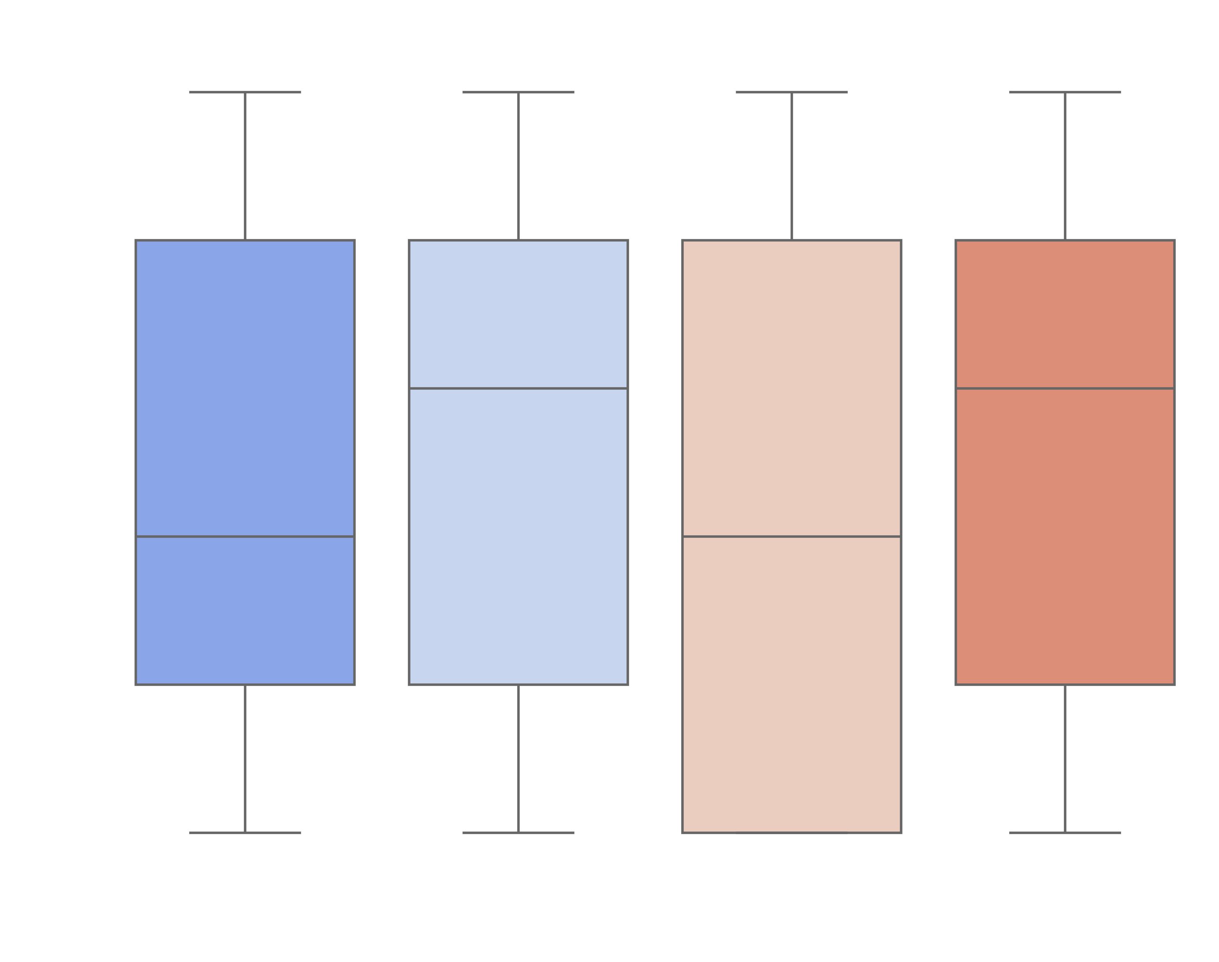
Caffeine and Sleep Quality
Caffeine is a common stimulant that can significantly impact sleep quality. While it helps students stay awake and focused during late night study sessions, caffeine can also delay sleep onset, reduce total sleep time, and disrupt deep sleep stages.
Even when consumed hours before bedtime, caffeine can remain in the body and make it harder to fall asleep or stay asleep. Relying on caffeine can lead to a cycle of poor sleep.

Slide 20
Caffeine and Sleep Quality
Caffeine is a common stimulant that can significantly impact sleep quality. While it helps students stay awake and focused during late night study sessions, caffeine can also delay sleep onset, reduce total sleep time, and disrupt deep sleep stages.
Even when consumed hours before bedtime, caffeine can remain in the body and make it harder to fall asleep or stay asleep. Relying on caffeine can lead to a cycle of poor sleep.

Slide 21
CONCLUSION
In conclusion, sleep quality is a crucial yet often overlooked factor in students' academic success and overall well-being.
Through understanding sleep patterns, we see the strong connections between good sleep, cognitive function, and emotional health.
Poor sleep habits, often influenced by academic pressure, lifestyle choices, and caffeine, can negatively impact memory, concentration, and stress levels.
By recognizing the importance of healthy sleep routines, students can take proactive steps to improve their academic performance, especially in India where the work and study pressure is humongous.

Slide 22
THANK YOU
:
D
Presented by : Somay (38027), Shivam (38040), Anand (38015), Keshav (38046)

